Slide 1
Welcome!
2021-22 School Year
MultiLanguage Learner (ELL) Program

Slide 2
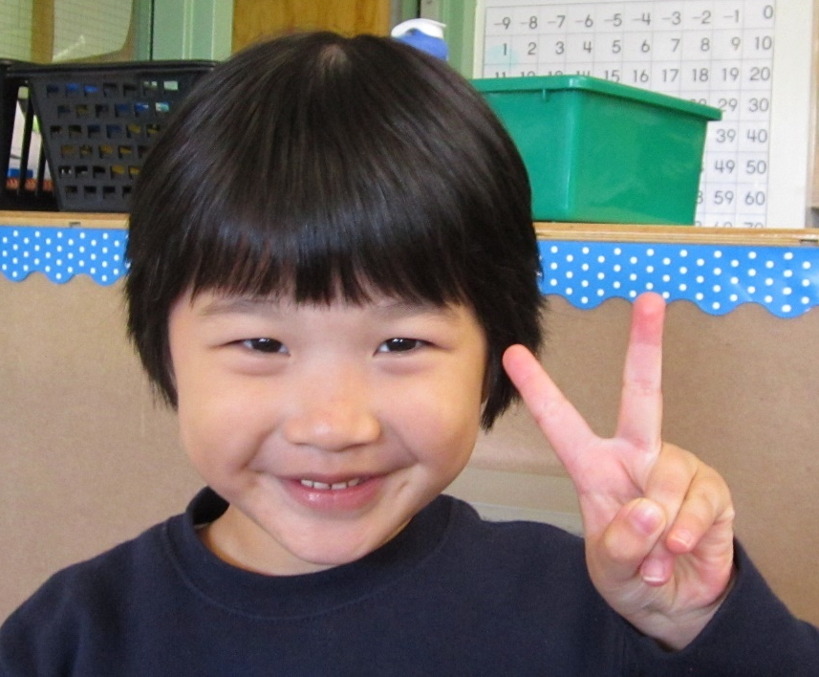
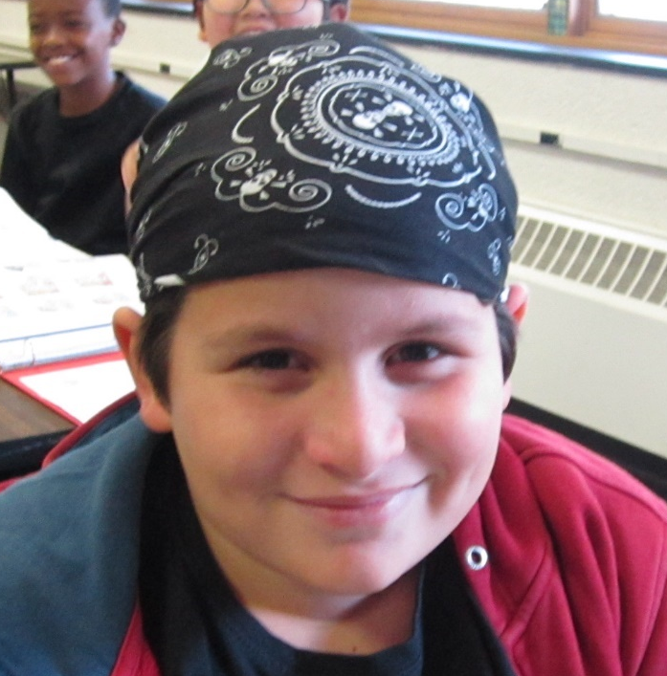
English Language Learners
GOAL: Improving our Students’ English while helping them gain subject matter concepts

Slide 3
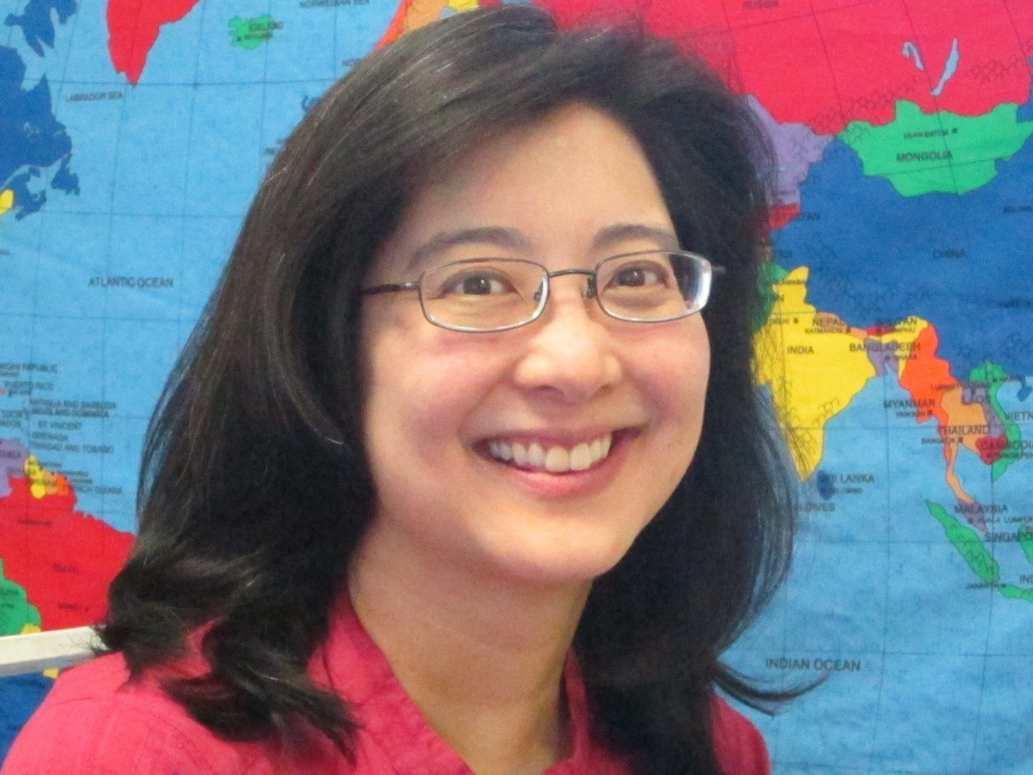
Who’s Who
Mrs. Bungard
ELL Teacher
Mrs. Brown
ELL Paraprofessional

Slide 4
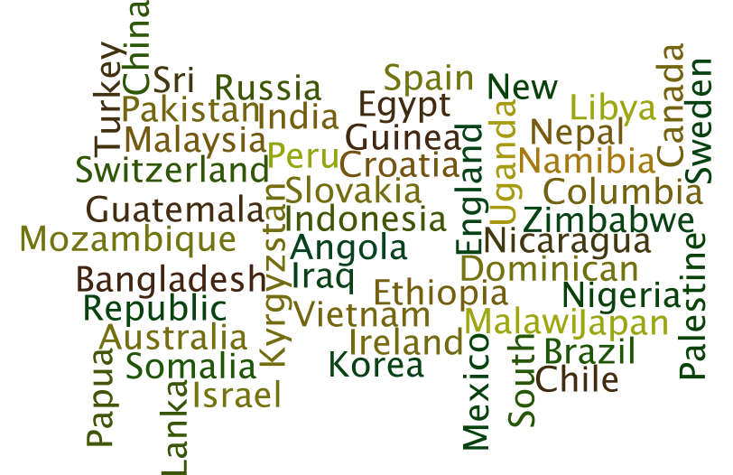
Countries of Glencairn
42 Countries Represented

Slide 5
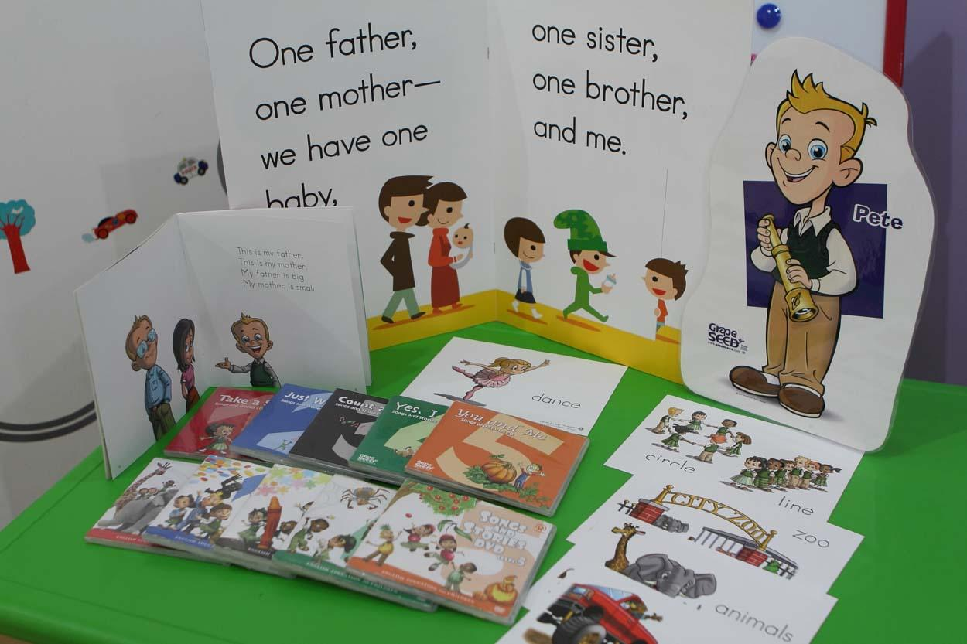
Curriculum-Beginners
GrapeSeed Curriculum for beginners
Intended for grades Kindergarten - 2nd grade
Is used in 16 countries and over 400 schools, serving more than 40,00 students daily
10 Units are available for teacher instruction
Students will receive instruction in GrapeSeed for approx. 30-45 minutes
3-5X a week
Take home material will be
provided
http://glencairnells.weebly.com/grapeseed-program-k-2.html

Slide 6
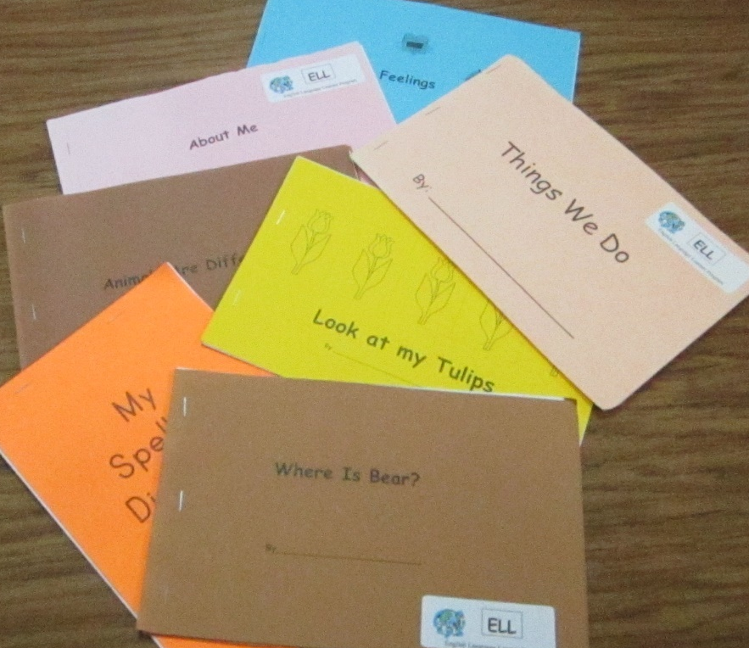
Curriculum-Beginners
Emergent Reader Books for Beginners
Intended for students in Grades 2-5
Vocabulary Development
Patterns of English
Repetition of Language
Reading at Home
Students will receive
instruction approx. 30 – 45
minutes, 2-5X a week
http://glencairnells.weebly.com/take-home-books.html

Slide 7
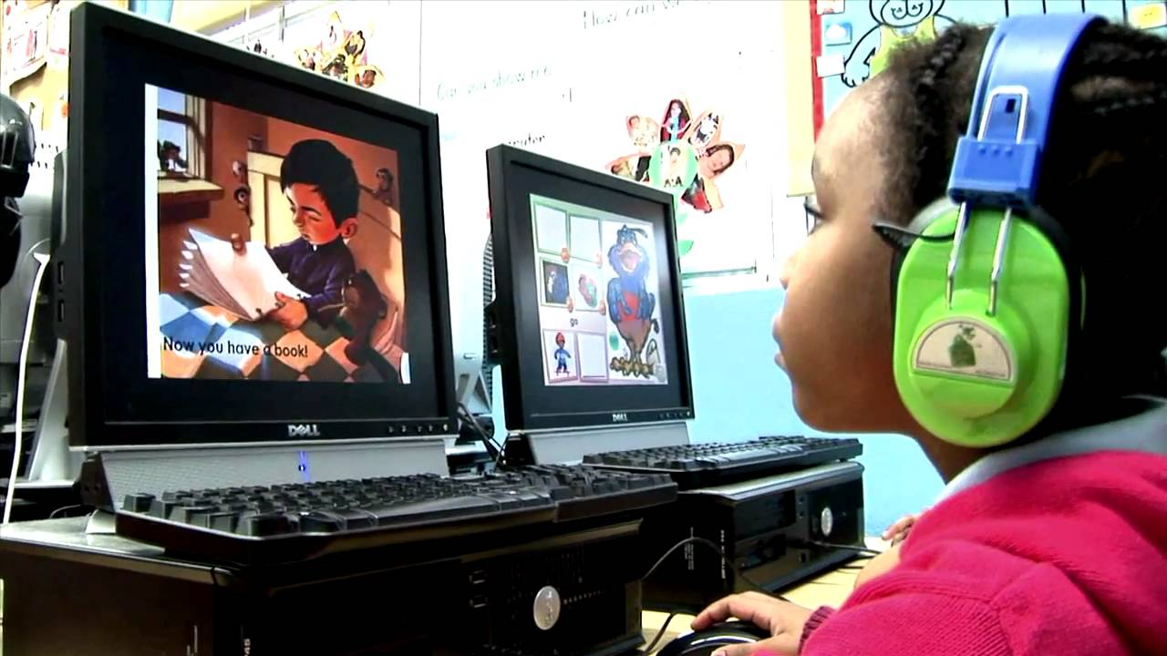
At Home Activities
Grades K-2
GrapeSeed take home materials (only K-2)
Take home books (occationally)
Imagine Learning (only grade 2-5)

Slide 8
At Home Activities
Grades 3-5
Take home books
Imagine Learning
Kids A-Z
Take Home Books
Imagine Learning
Kids A-Z

Slide 9
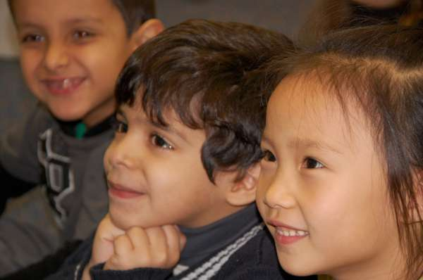
Curriculum-Intermediate
Intermediate students will be receiving services by Mrs. Brown and Mrs. Bungard (limited availability).
Mrs. Brown or I will help the classroom teacher teach the intermediate student content level vocabulary and concepts.
Writing will be a focus point.

Slide 10
Question & Answer Time

