Slide 1
End of Recess Procedures
What to do when the recess bell rings, or the
whistle blows And recess is over

Slide 2
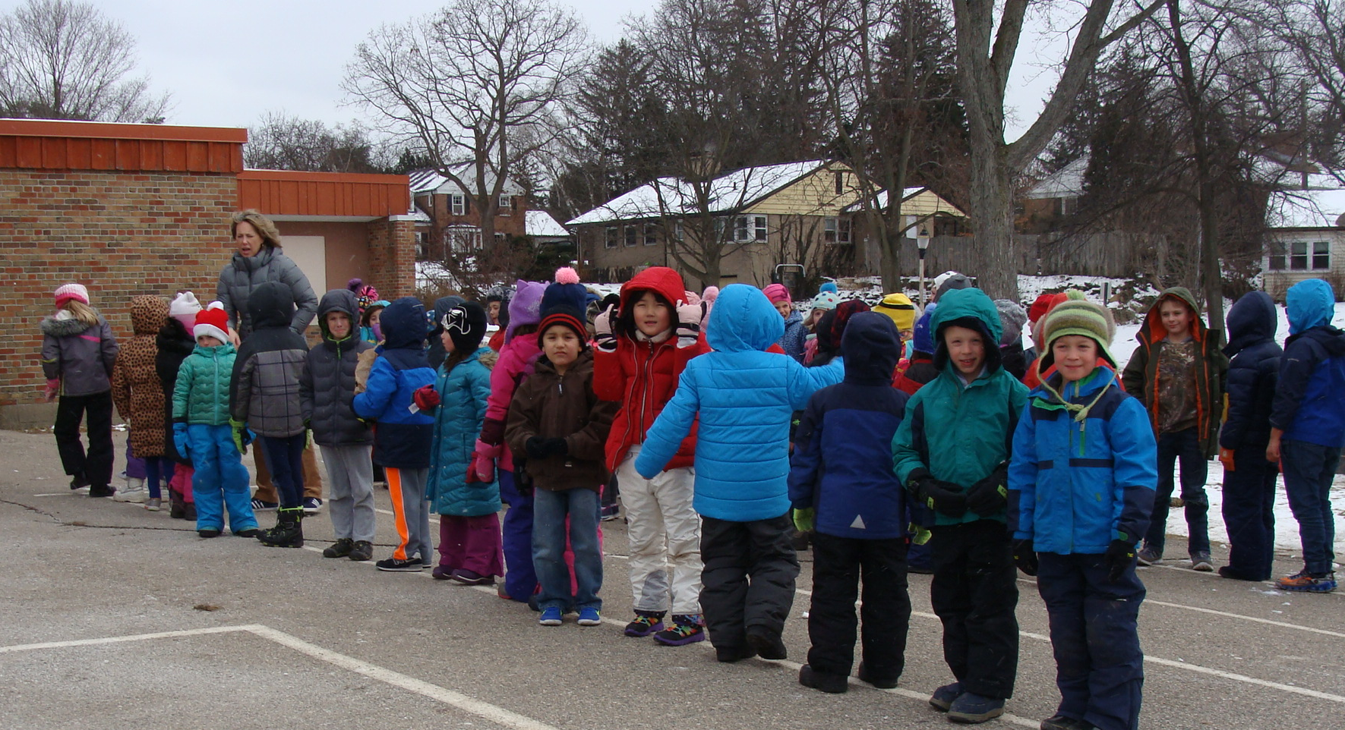
When the bell rings, or the whistle blows, stop what you are doing and line up right away with your class.

Slide 3
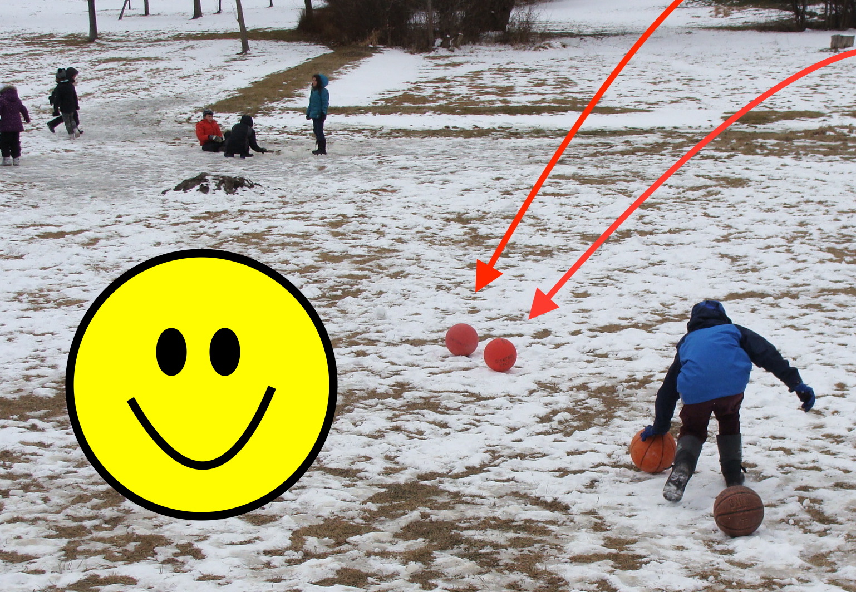
Look around for balls or playground equipment that needs to be put away.

Slide 4
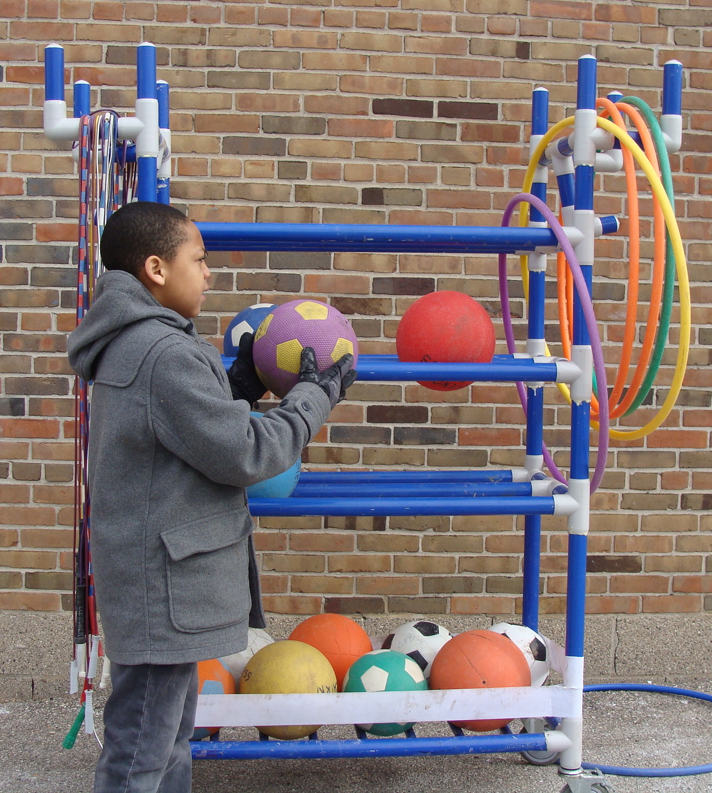
Return balls, jump ropes and hula hoops to the ball cart.

Slide 5
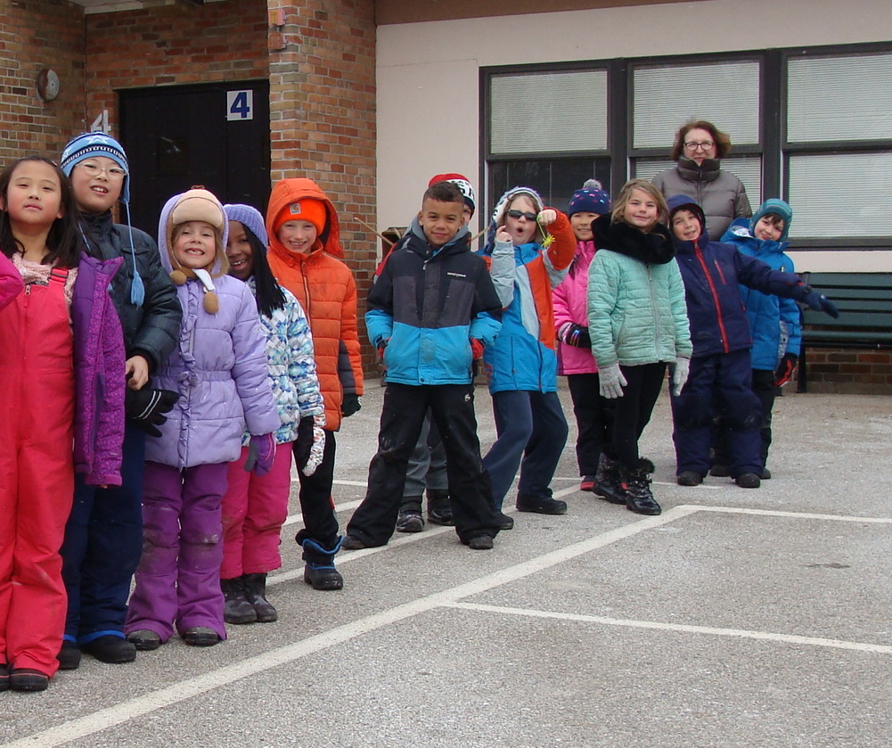
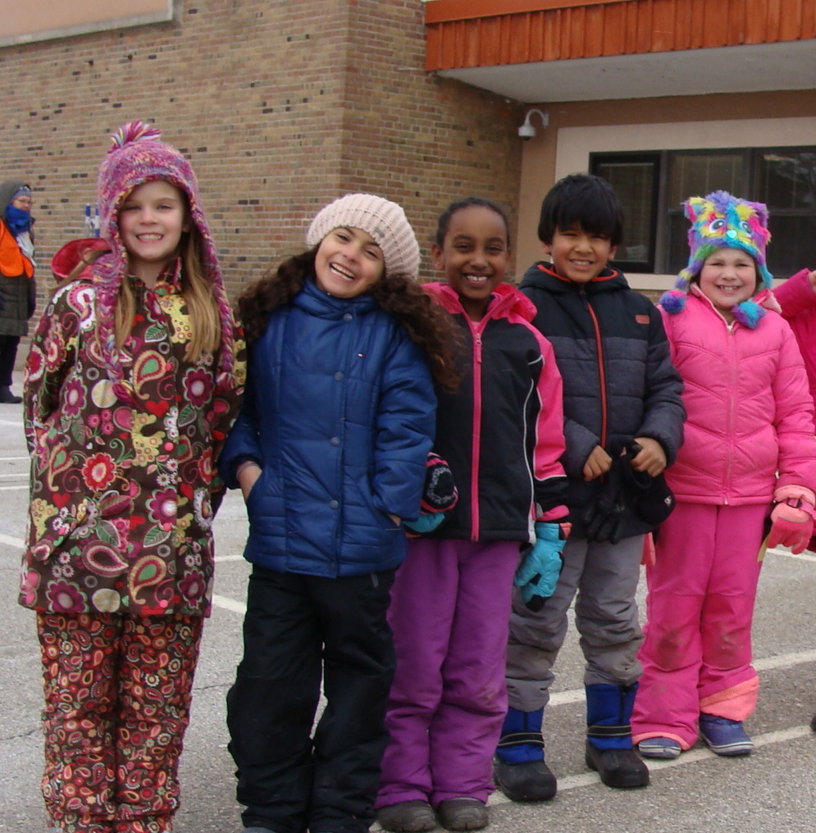
While you wait for others, stay in line and keep your hands to yourself.

Slide 6
And Don’t Forget…

Slide 7
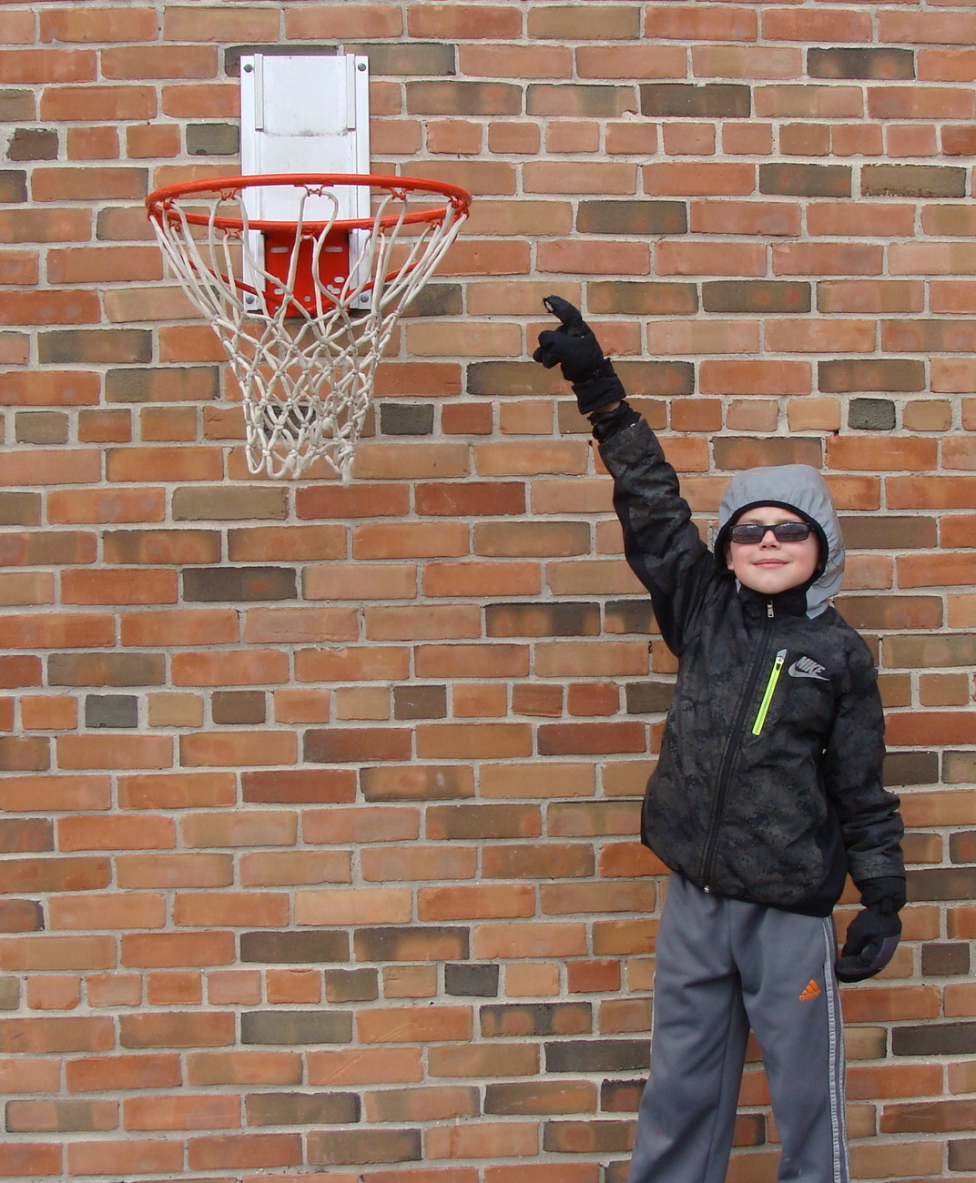
Never hang or jump on the basketball hoops because the basketball hoops could break and fall on you. Stay off of the hoops even when your in line.

Slide 8
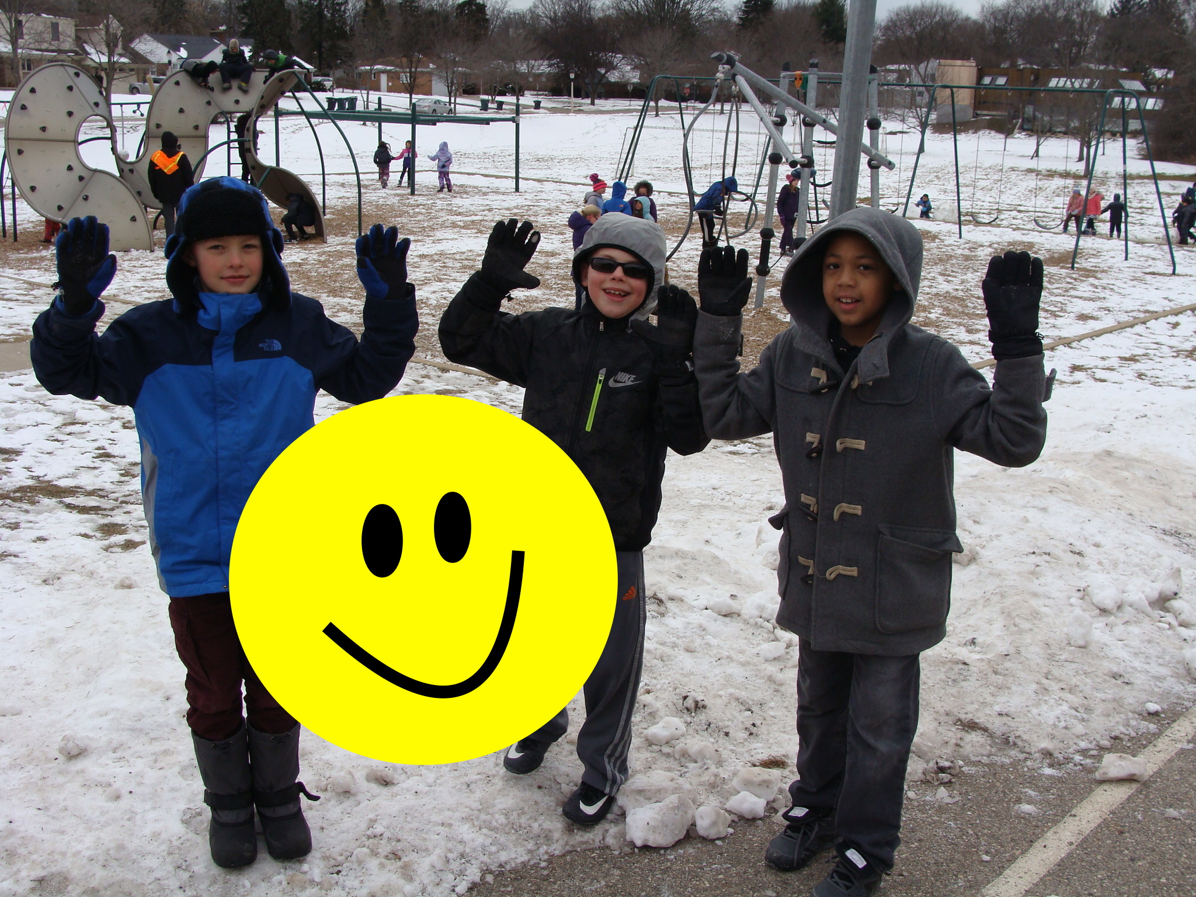
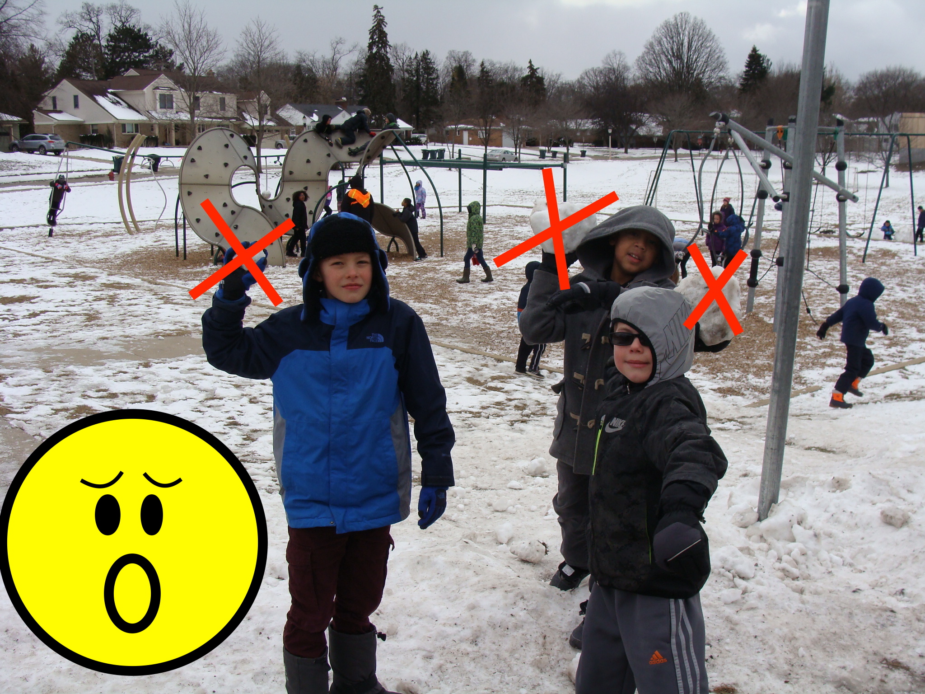
In the winter…
Snow Stays on the Ground!
YES!
NO!

Slide 9
Thank you!

