Slide 1
What it IS - What it means – What it Offers
State Assessment in Michigan

Slide 2
Expecting More
Getting children ready to take their place in the world is challenging.
The knowledge and skills students need for a well-paying job continually evolve to meet current and future workplace demands.
Notes:
Parent Discussion Points
Most students will have 12-15 jobs or more in their lifetime. (Bureau of Labor Statistics).
Estimated number of careers in a lifetime – Seven.
Living in a new economy-powered by technology, fueled by information, and driven by knowledge.
Today’s students may be competing for jobs nearby or across the globe.
Need to routinely strengthen education standards to meet workplace and/or college demands.

Slide 3
Expecting More
To ensure students can meet these demands, the State Board of Education routinely strengthens Michigan learning standards.
State standards broadly outline what students need to know and be able to do in each subject and grade level to be career- and college-ready upon high school graduation.

Slide 4
Expecting More (cont’d)
Today's standards challenge students to:
Understand subject matter more deeply.
Learn how to think critically.
Apply what they are learning to the real world.
Make learning relevant in their lives.

Slide 5
What are Michigan Standards?
They are EDUCATOR DEVELOPED learning goals for mathematics, English language arts (ELA), science, and social studies.
They prepare students for college and careers.
They help students compete nationally and internationally.
They are not a curriculum or federal program.

Slide 6
New Standards, New Assessments
New learning standards require new ways to measure how much students know and can do.
That’s why in 2015, Michigan replaced the 44-year-old MEAP test with the NEW Michigan Student Test of Educational Progress (M-STEP), and continues to look for ways to improve its system of standardized assessment.

Slide 7
Measuring Progress
Each spring, all students take a high-quality state assessment.
M-STEP is given to elementary and middle school students each spring.
In grades 3 through 8, English language arts and mathematics standards are measured by M-STEP.
Science and social studies are measured in grades 5, 8 and 11.

Slide 8
Measuring Progress
PSAT (PreSAT) is an option for districts and is given each spring to students in grades 9 and 10.
Starting in 2019, schools will be required to give the PSAT to students in grades 8, 9, and 10

Slide 9
Measuring Progress
Michigan Merit Exam (MME) assesses students in grade 11 and includes:
SAT with Essay college entrance exam, which also measures English language arts and mathematics standards.
M-STEP science and social studies exams.
ACT WorkKeys assessment, which measures work skills.

Slide 10
Support for Students
To prepare students for the College Board’s PSAT and the SAT with Essay, Michigan students have free access to the Khan Academy for online test practice. collegereadiness.collegeboard.org/sat/practice
For more information on the PSAT and SAT, please visit: the College Board’s Michigan website at Michigan College Board web page.

Slide 11
Why State Assessments Are Important
State assessments like M-STEP and MME are “summative,” meaning they measure what students have learned during the year in relation to Michigan’s career and college-ready learning standards.
1
They are required under both state and federal law, to ensure all children are learning and receiving a high-quality education.
2

Slide 12
What Do State Assessments Provide?
An important snapshot of achievement at the student, building, district and state level.
Valuable information for teachers to use to align classroom instruction and lesson plans with state standards.

Slide 13
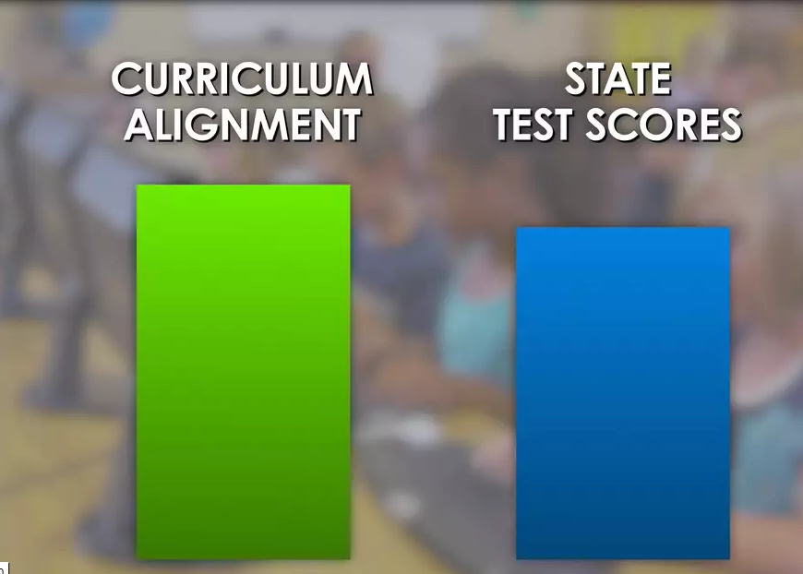
Curriculum Alignment and Test Scores
The more aligned a school’s curriculum and education is to state standards, and the more students learn, the higher state test scores are likely to be.

Slide 14
When Does My Student Take State Assessments?

Slide 15
Online Testing Schedule
To provide districts and schools scheduling flexibility, online M-STEP testing sessions can be scheduled on any instructional day within a 4-week window.
Not all students need to be administered the same assessment at the same time, nor on the same day.
Test sessions are not timed (with the exception of College Entrance and Work Skills Tests). Students should be allowed extra time if they need it.

Slide 16
Spring 2018 Online Testing Schedule
Grade Level | Assessment Used and Content Area Assessed | Testing Window
Grades 3, 4, 6, 7 | M-STEP Mathematics and ELA | April 30 through May 25
Grades 5 and 8 | M-STEP Mathematics, ELA, Science, and Social Studies | April 9 through May 4
Grades 9 and 10 | PreSAT (PSAT) | April 10 or 11 April 24 or 25 (Makeup)
Grade 11 MME | M-STEP Science and Social Studies | April 9 through May 4
Grade 11 MME | SAT | April 10 or April 24 (Makeup)
Grade 11 MME | ACT WorkKeys | April 11 or April 25 (Makeup)
All grades | MI-ACCESS Alternate Assessment – all grades, all content areas | April 9 through May 25
All grades | WIDA for students who are learning the English language | February 5 through March 23

Slide 17
Student Time Spent on State Assessments
Students spend on average 3-7 hours total taking a state assessment — depending on grade or <1% of instructional time.
All other assessments are determined at the local district or building level.
Preliminary results are available to schools within 24-48 hours.
Final results released in late summer prior to the beginning of school.

Slide 18
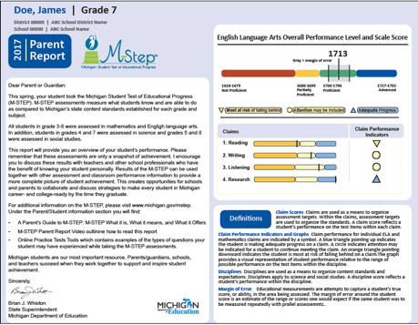
Final Test Results
Schools receive a printed report they give to parents and guardians that describes their student’s performance on the subjects tested by M-STEP and MME, which differ by grade.

Slide 19
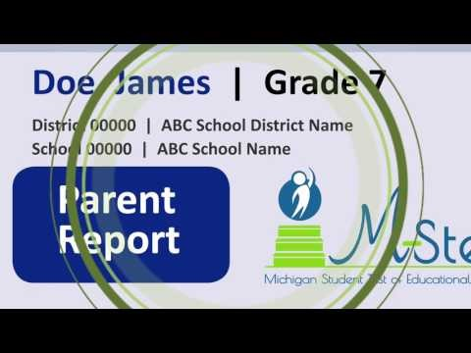
Test Results (cont’d)
To help walk you through a parent report, MDE has developed a short video and information piece for each assessment:
How to Read Your Child’s Score Report Video
M-STEP - How to Read Your Child's Score Report for Grades 3-8
MME - How to Read Your Child's Score Report for Grade 11

Slide 20
Test Results (cont’d)
Your student’s teacher can explain each of these reports in more detail and describe how your child is doing in each area. The teacher can also discuss what you can do to help your child succeed.

Slide 21
Questions?
Visit the M-STEP web page parent section at www.Michigan.gov/mstep
Visit the MME web page at http://www.michigan.gov/mme
Contact the MDE Assessment and Accountability Office at baa@Michigan.gov or 877-560-8378 (toll-free)

